Slide 1

DataWave Music
Analytics
By Isioma Ekejiuba
1:23
2:36

Slide 2

Data Overview
DataWave has successfully collected user engagement data, including user demographics (country, age), subscription type, average listening hours per week, satisfaction score and churn status.
However, during data assessment, several inconsistencies and inaccuracies were observed:
Missing columns - some expected columns in the data dictionary were not present
Missing user data - for instance, satisfaction scores, monthly fees, and even user IDs
Duplicated records
Unstandardised data - e.g., “UK” and “United Kingdom” were treated as separate entities
Mismatched monthly fees - users on the same plan had different fees, and some free plan users were charged
Incorrect formatting - e.g., “ten” instead of 10 in numeric columns.

Slide 3

Data Overview
During the data cleaning process, some assumptions were made to proceed with the analysis:
Analysis focused only on available columns
Missing gender data was replaced with “Prefer Not To Say” to protect privacy
Missing satisfaction scores were replaced with the median score (which was 3.0)
While the original monthly fee column was retained for reference, a new column was created with updated fees: Free = £0, Student = £5, Premium = £9.99, Family = £12.99. These assumptions were not used in the analysis until confirmed.

Slide 4
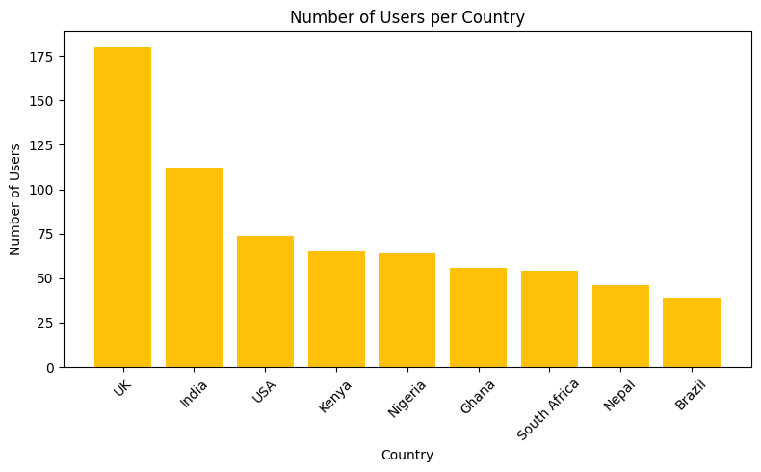
Number of Users by Country
Key Insights
DataWave has fewer than 100 users in the USA, Kenya, Nigeria, Ghana, South Africa, Nepal, and Brazil – with Brazil being the lowest (39 users)
This raises questions about adoption rate:
Is awareness low?
Is marketing insufficient?
Are there obstacles in customer acquisition?

Slide 5
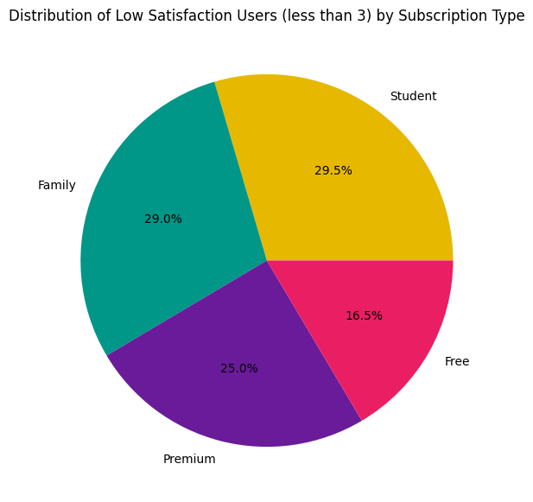
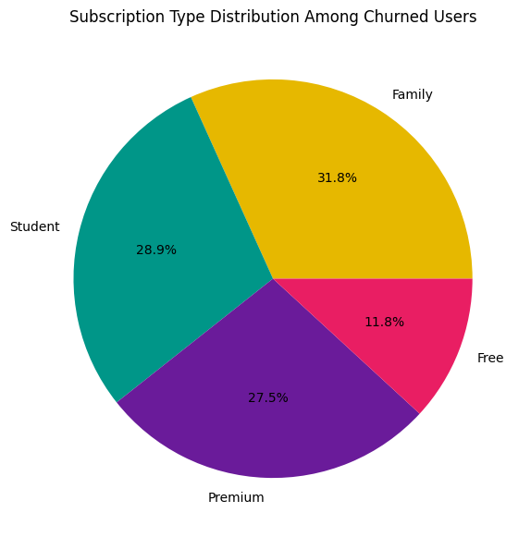
Subscription Type
Key Insights
Satisfaction Score
Churn Status
Users scoring below 3 in satisfaction score are mostly on Student and Family plans
Churn is also highest among Family plan users
Are fees too high?
Are perks insufficient?

Slide 6
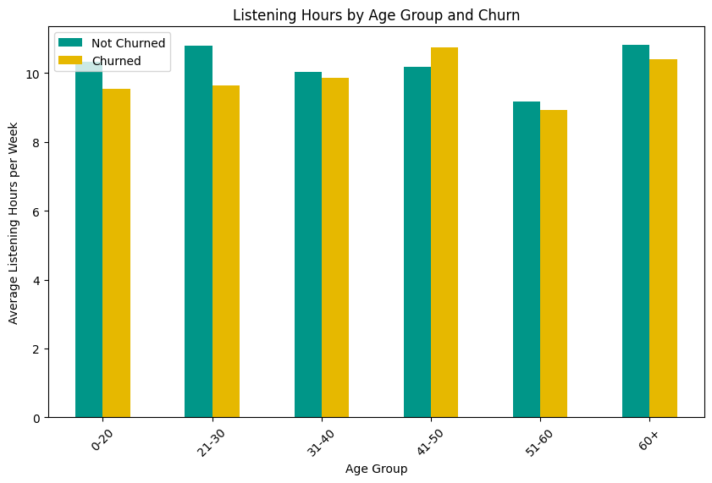
Average Listening Hours per Week by Age & Churn Status
Key Insights
Across age groups, average listening hours are 9–11 hours per week
Interestingly, the 41–50 age group listens the most but also churns the most
Is DataWave really appealing to all age groups (for instance, maybe in available music) or are some being neglected?

Slide 7
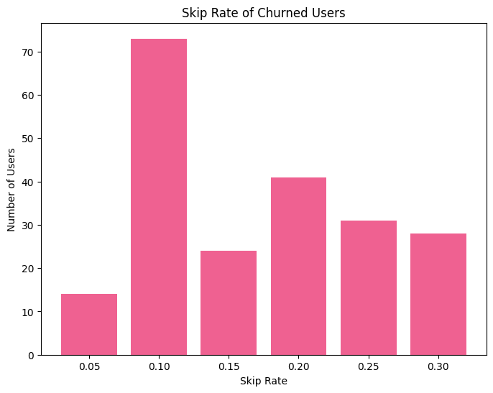
Skip Rate and Churn Status
Key Insights
Skip rate measures how often users abandon songs before they finish
Most churned users have a skip rate of 0.10, indicating they mostly listened fully but still left
This implies that engagement alone doesn’t prevent churn
What other factors could cause them to churn - music variety? subscription type? or additional perks?

Slide 8

Conclusions
Conclusions & Recommendations
DataWave has very low adoption in countries like Brazil, Nepal, South Africa, Ghana, Nigeria, Kenya, and the USA – with Brazil being the lowest
Unsatisfied users are primarily on Student and Family plans, with Family plan users seeing the highest churn
The 41–50 age group has the highest listening hours but also the highest churn
Most churned users listen fully to music most of the time

Slide 9

Recommendations
Conclusions & Recommendations
Boost Marketing in Low-Adoption Countries
Reassess Subscription Plans
Tailor Music Selection by Age Group
Expand Music Variety

Slide 10
Thank you!
Questions?
Contact me at: isioma.ekejiuba2025@my.ntu.ac.uk
Nottingham Trent University
Msc Data Science
1:23
2:36

